Slide 1
Regional Investment Readiness and Impact Fund
NORTHERN TERRITORY
30 April 2026
Katrina Kawaljenko
Notes:
Good morning and thank you for taking the time to join us today.
This is an online session that is being recorded.
My name is Katrina Kawaljenko, CEO of Regional Development Australia (RDA NT), and I’ll be taking you through the Regional Investment Readiness and Impact Fund — or RIRIF.
Today I’ll step through:
what the program is designed to do
what it will and won’t fund
and what we’re really looking for in strong applications
I’ll keep this practical and focused,and we’ll should have time at the end for questions.
[PAUSE]

Slide 2
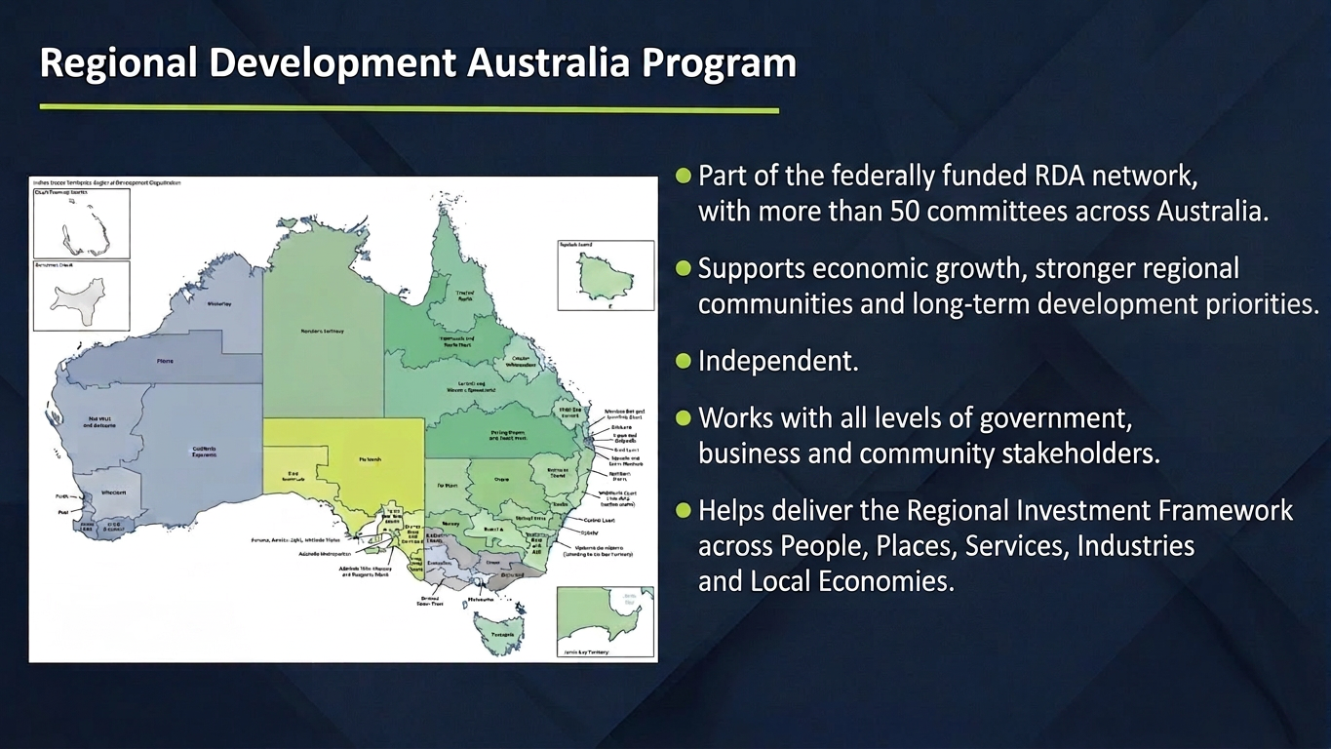
Notes:
For those of you that haven’t worked with RDA NT Before, I will just give you a brief background on our organisation.
Regional Development Australia Northern Territory is part of a national network that supports regional economic development across Australia.We work across all levels of government, industry and community to identify opportunities, remove barriers, and support regional priorities and projects.
Whilst we are Federally fund, we are independent and not part of a government Department.

Slide 3
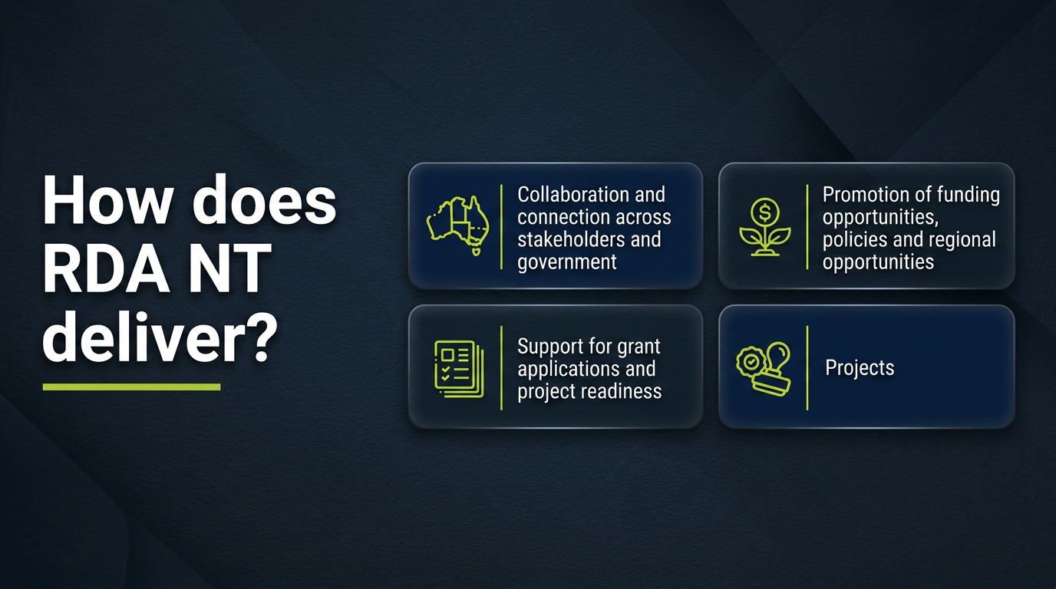
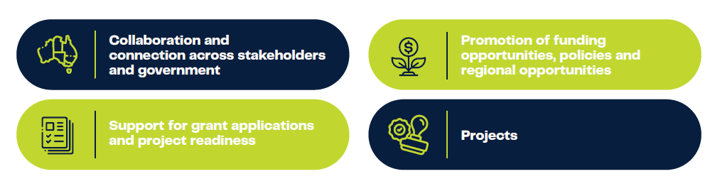
How does RDA NT deliver?
Notes:
We operate as an independent, evidence-based organisation.
We act as a connector —bringing together communities, government, and parenters
We support grant applications. We provide regional data and intelligenceto help shape stronger, more credible projects.
We promote funding opportunities, policy and regional opportunities.
Our role is to support others — including local governments, organisations and communities —to develop and progress projects.
[PAUSE]
So our focus is always on helping projects move forward —not just generating ideas, but actually progressing them.

Slide 4
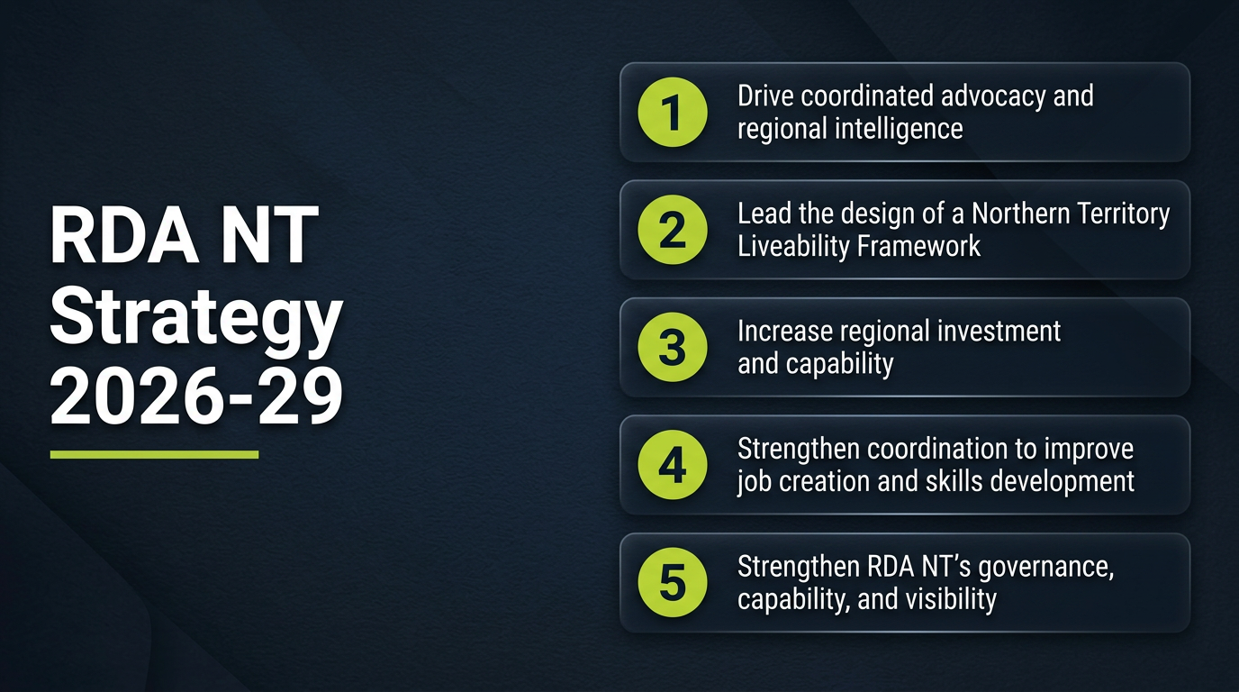
Notes:
In February this year, we launched our RDA NT strategy, which was informed by a stakeholder survey and consultation. The RIRIF is part of our implementation of Goal 3- increase regional investment and capability. .
[PAUSE]
More information about our strategy is on our website.

Slide 5
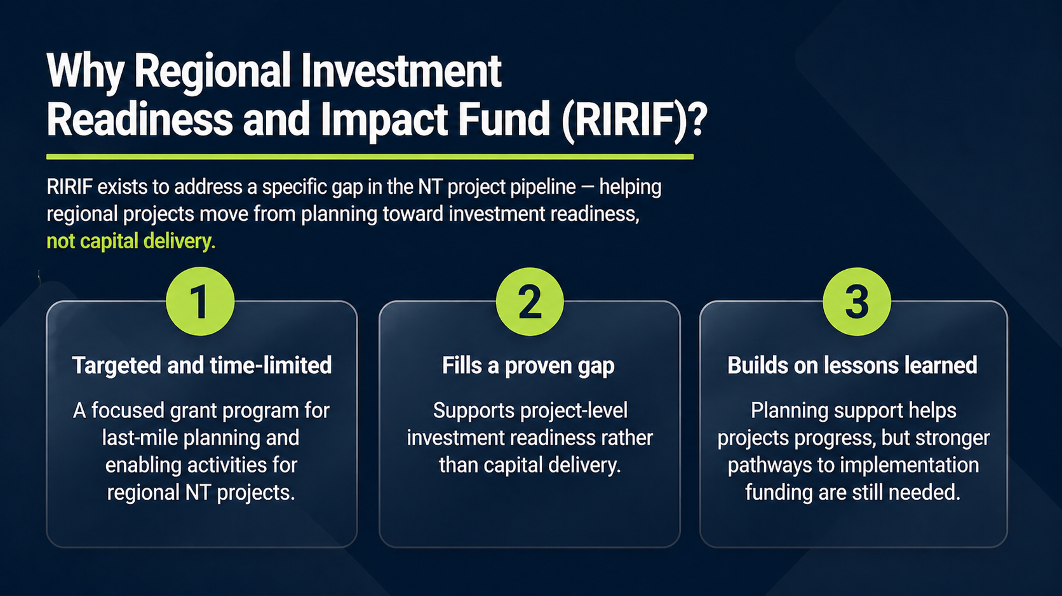
Notes:
RIRIF exists to address a specific gap in the NT project pipeline- helping regional projects moved from planning toward investment readiness, not capital delivery.
1. This is a targets and time limited program- focused on last mile planning to support projects to be funded.
2. This program exists because of a very clear and consistent gap.
Across the Northern Territory, we see strong project ideas —often with real community need and support —but they don’t progress.
[PAUSE]
Not because they lack value —but because they’re not yet investment-ready. What we commonly see is: projects without a detailed business case
projects without clear technical or design work or projects without a defined pathway to funding …and that’s where they stall.
[PAUSE — let this land]
So the issue isn’t a lack of ideas.It’s a lack of readiness.RIRIF is designed to address that gap —by supporting the work needed to move projects from planning
into a position where they can actually secure funding and move forward.
3. we’re building on lesson learnt.
From our involvement in projects, we know that planning support helps projects progress, but stronger pathways to implemneation funding is needed.
We have also learn from our own experience in delivering grants as an organisation, through our previous program Seeding New Investment Fund, through our review of these previous funding rounds, we’ve listened to feedback to create a grant program to deliver outcomes.

Slide 6
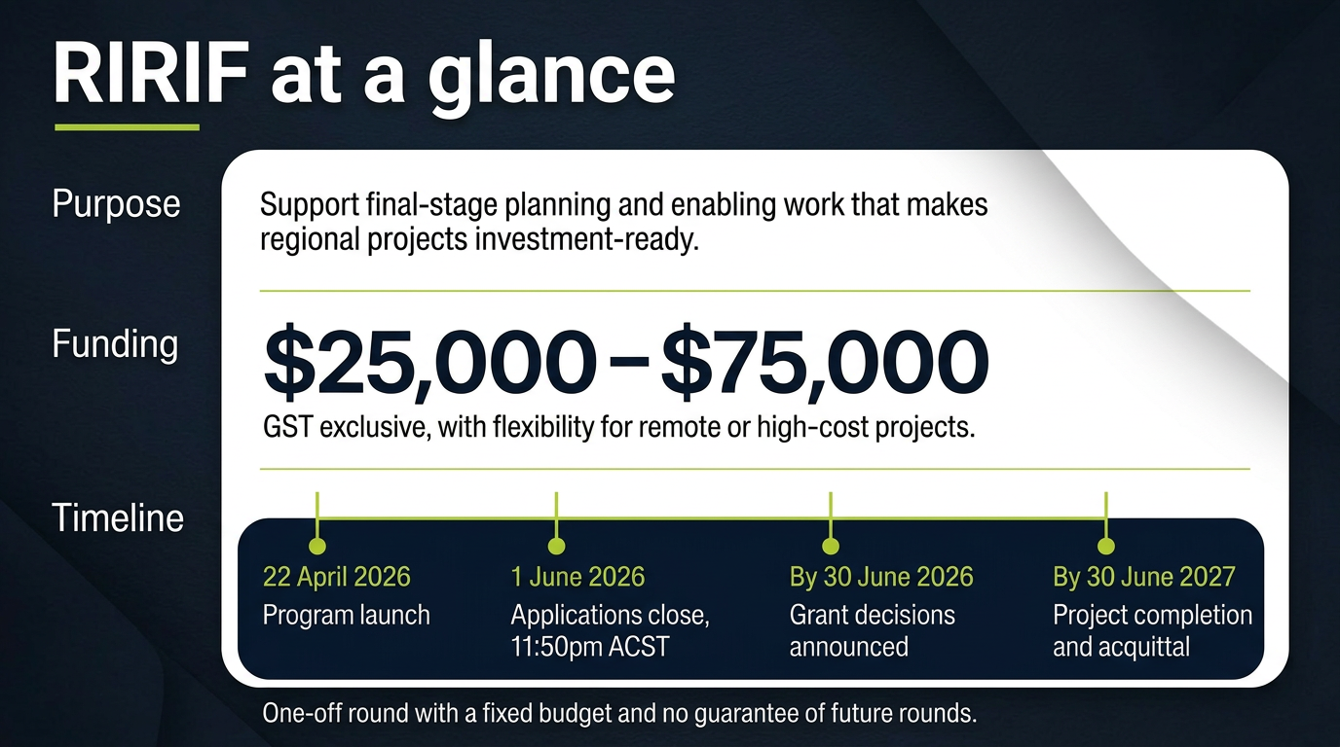
Notes:
This slide outlines the key parameters of the fund.
RIRIF is a one-off, time-limited grant round with a fixed budget and clear delivery timeframe.
It is so support final-stage planning and enabling work to make regional projects invesement-ready.
The typical grant range is between $25,000 and $75,000, although some flexibility may be considered for remote or high-cost projects where there is strong justification.
PAUSE
The important point is that this funding is for planning and enabling work — not delivery.
Projects need to be achievable within the program timeframe, and applicants need to show that the proposed work is realistic, costed, and directly linked to progressing the project toward implementation funding.

Slide 7
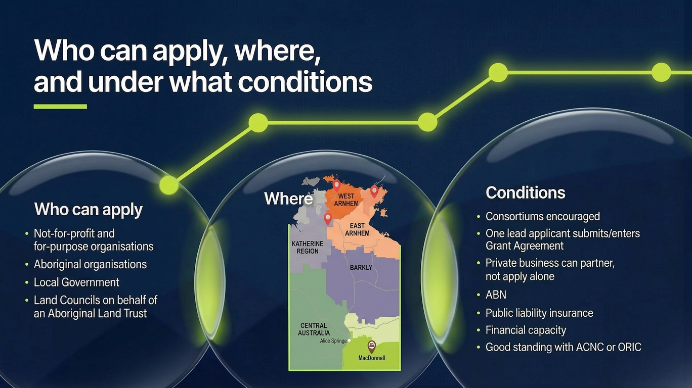
Notes:
This slide explains who the program is designed for.
RIRIF is primarily focused on regional and remote Northern Territory projects.
Eligible applicants may include not-for-profit organisations, for-purpose organisations, Aboriginal-controlled organisations, local government bodies, and similar eligible entities. You must have a physical presence in the NT.
PAUSE- This grant is about regional and remote NT.
The key point is that applicants need to demonstrate genuine community or regional benefit. And it has been designed to focus on investment in our regional areas.
Greater Darwin and Palmerston applications may be considered, but only where the project clearly enables outcomes in regional or remote areas.
Community benefit must be demonstrated; this is especially important where a private or commercial partner is involved.
You must have an ABN, public liability insurance, financial capacity and good standing with organisations like ACNC, ORIC etc.
The can only be one lead applicant who must submit the grant application and consotriums are encourage.

Slide 8
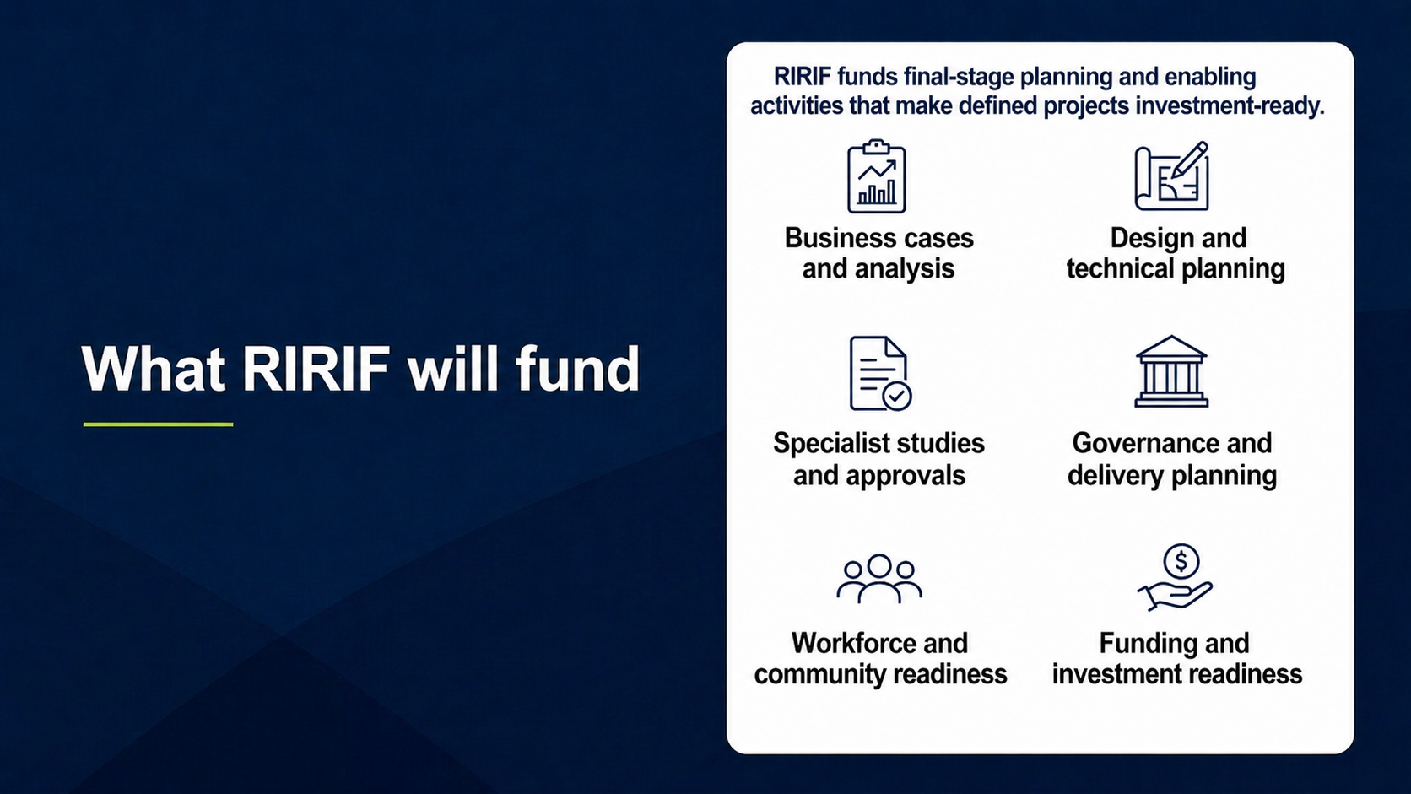
Notes:
RIRIF funds final-stage planning and enabling activitiesthat make defined projects investment-ready.
That includes activities such as:
business cases and financial analysis
design and technical planning
specialist studies and approvals
governance and delivery planning
workforce and community readiness
funding and investment readiness.
Example could include: engineering and architectural planning, studies such as environmental, cultural heritage or geotechnical, stakeholder engagement strategies, community engagement and co-design.
[SLOW DOWN]
The key question we apply is very simple:
Does this activity directly help the project secure implementation funding?
[PAUSE]
If the answer is yes —then it is likely to be in scope.
If the answer is no —then it’s probably not aligned with the program.
[PAUSE]
This is often the difference between a project being interesting and being something a funder can actually assess and invest in.

Slide 9
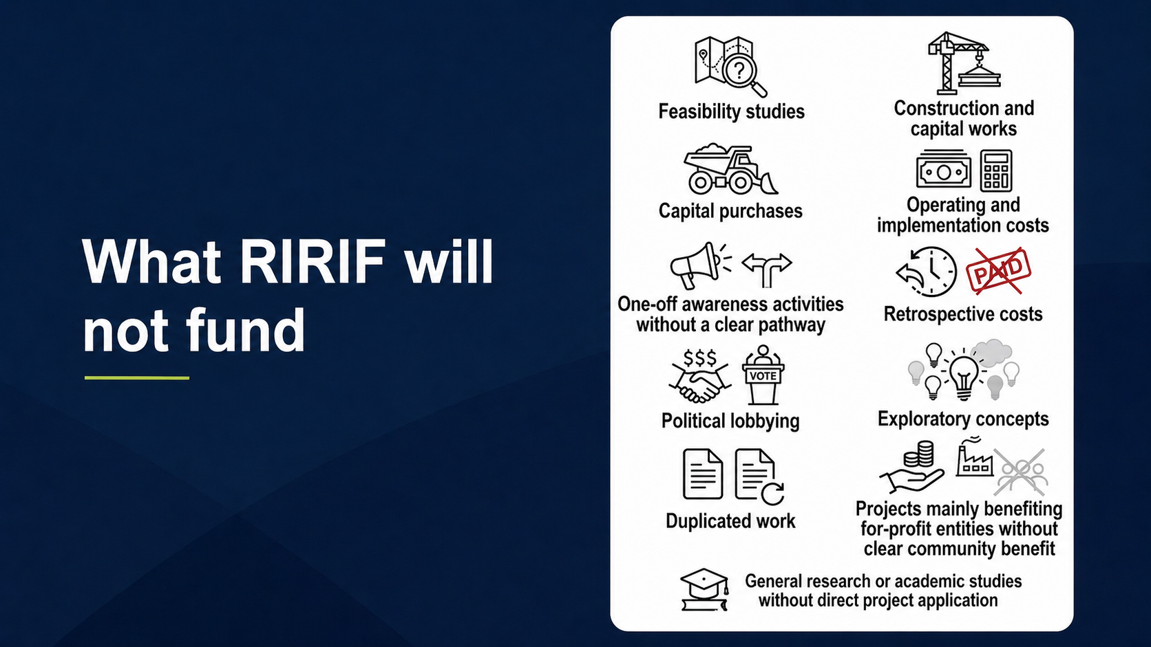
Notes:
It’s just as important to understand what the program does not fund.
We do not fund:
feasibility studies – project must already be beyond this stage
capital works or infrastructure delivery
ongoing operational or staffing costs
early-stage concepts
Retrospective costs
Political lobbying
or general research without direct project application
The guidelines also exclude exploratory concepts, duplicated work, and activities that primarily benefit for-profit entities without clear community benefit.
[PAUSE]
This is a deliberately tight and focused program.
It is focused to enable the program to be effective.
It ensures funding is directed toward projects
that are already well progressed and ready for the next step.

Slide 10
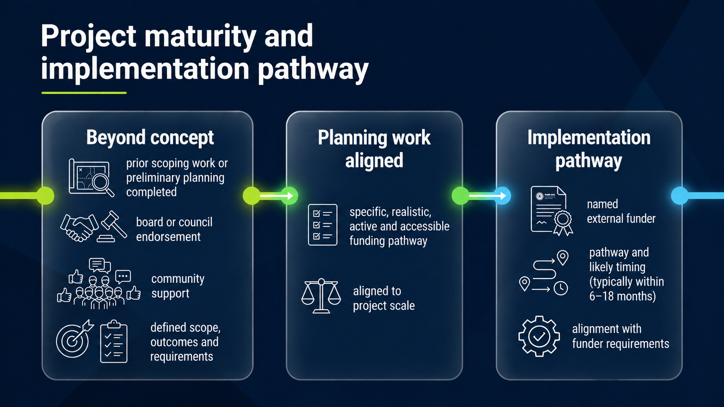
Notes:
This is the most important part of the program.
[PAUSE — emphasise clearly]
Projects must be beyond the conceptual or exploratory stage.
That means:
prior scoping work or preliminary planning has been completed
there is organisational endorsement
community support has been demonstrated
and the project scope, outcomes and requirements are clearly defined
[PAUSE]
But the critical requirement is the implementation pathway.
Every application must identify at least one specific external funding source —and clearly outline how the project will get there.
[SLOW DOWN]
That pathway must be:
specific
realistic
active
accessible
and aligned to the scale of the project
[PAUSE after list]
We are not looking for a long list of possible funding options.
We are looking for a clear and credible next step.
[PAUSE]
We also expect a realistic timeframe —
typically within 6 to 18 months.
So this needs to be something that is genuinely achievable.
[PAUSE]
Without a credible implementation pathway,applications will not be competitive.
[STRONG EMPHASIS]
This is where the strongest applications really stand out.

Slide 11
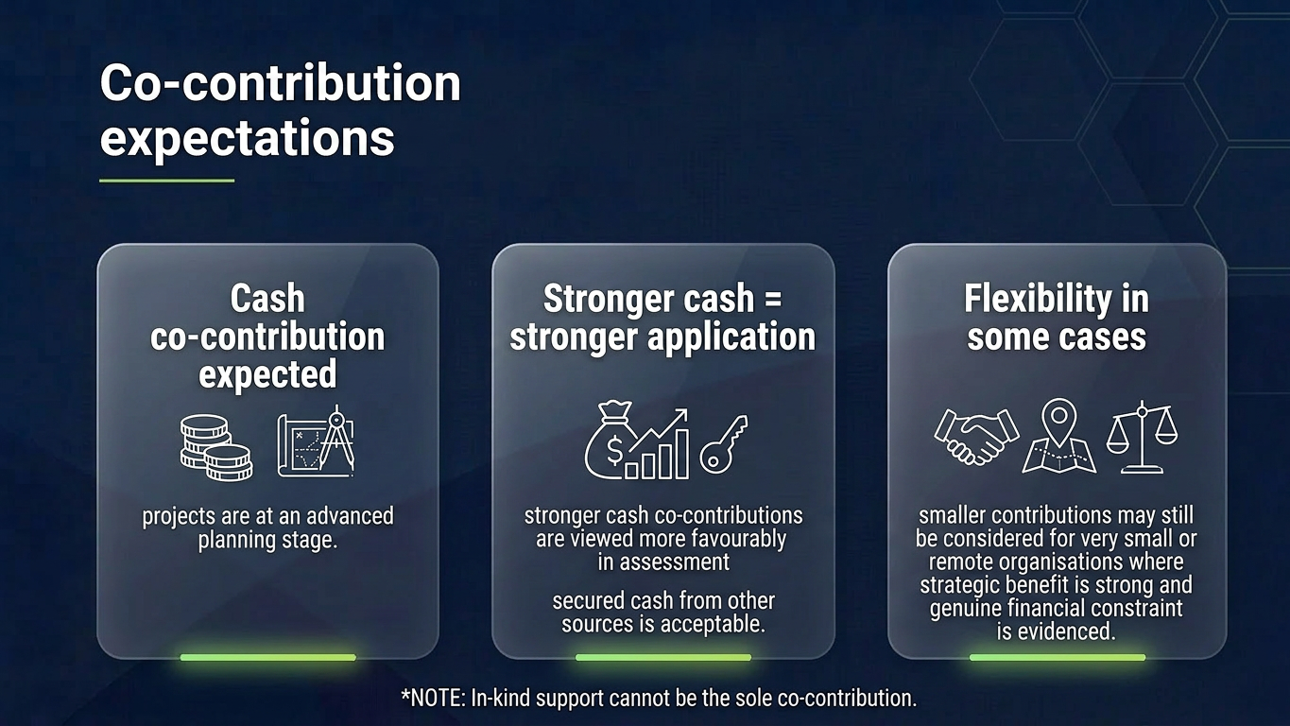
Notes:
Slide 11 – [Co-contribution / project commitment]
This slide is about commitment and readiness.
Because RIRIF supports projects at an advanced planning stage, applicants are expected to demonstrate that they already have some level of organisational commitment behind the project.
That may include a cash co-contribution, secured related funding,
PAUSE
A stronger cash contribution will generally strengthen an application, because it shows the project has real backing.
In-kind support can be useful to demonstrate overall commitment, but it cannot fully replace evidence of financial commitment. I must stress this and be clear this is about financial contribution.
We acknowledge this may be a barrier for some organisation, and flexibility will be applied where the strategic benefit is strong and genuine financial constraint is evidence.

Slide 12
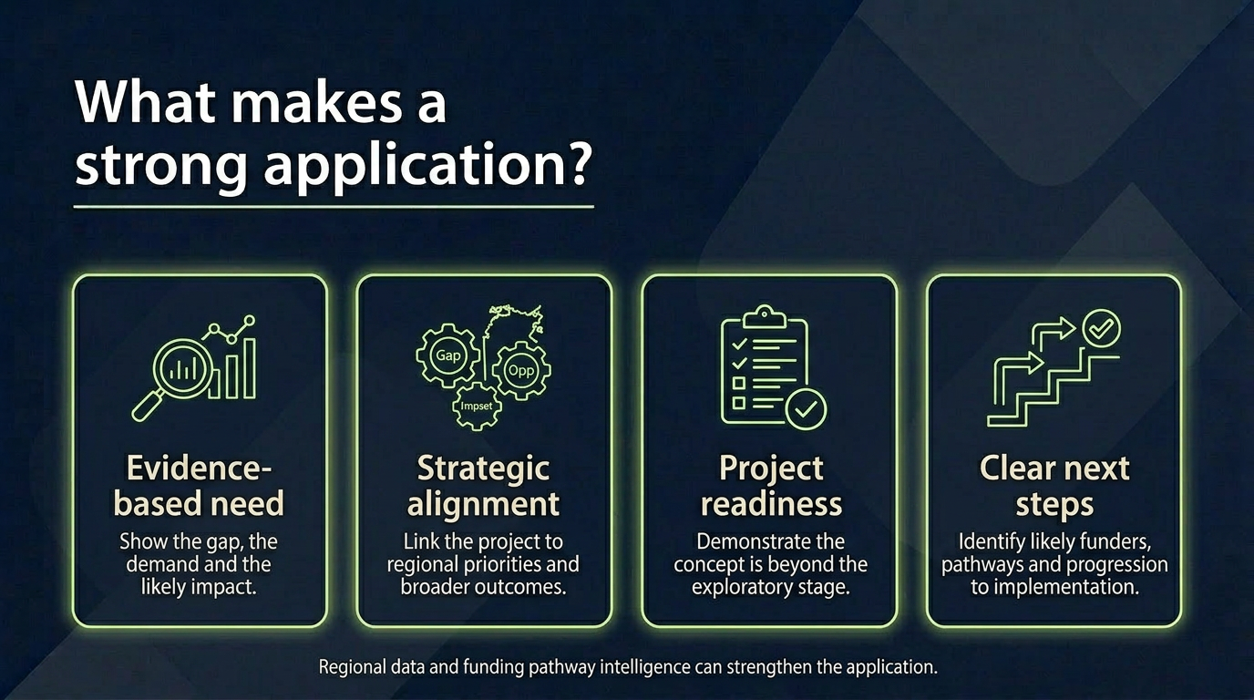
Notes:
What is going to make your application stand out?
Is it back by evidence- are you demonstrating the gap, the demand and likely impact and backing this up with supporting evidence such as data
Applicants need to show how their project aligns with regional priorities and broader strategic outcomes. That includes alignment with RDA NT’s strategic priorities, regional investment principles, and community-identified needs.
PAUSE
Strong applications will clearly explain why the project matters
That might include economic outcomes, liveability benefits, First Nations economic participation, improved services, stronger regional capability, or increased investment into the region.
Is you project ready? You must demonstrate that this project is beyond exploratory or concept stage. If this is a new idea, it probably isn’t likely to be at the project maturity stage for RIRIF.
You must be able to clearly articulate the next steps by naming at least one potential and real funding source.
The strongest responses will be specific — not just broad statements about benefit.
We’re after projects that with the support of RIRIF will be ready to be funded now.

Slide 13
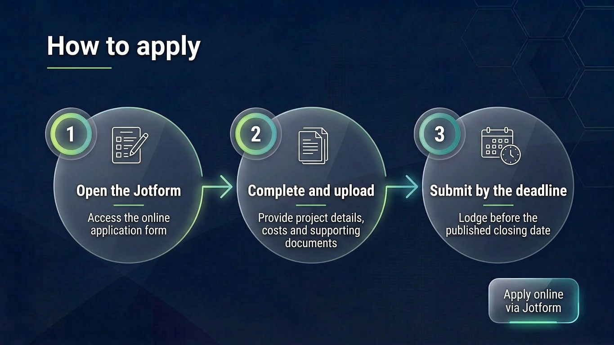
Notes:
All applications must be submitted via our jotform application on our website.
You need to complete all the mandatory information and upload the all your supporting documentation.
This include organisational details, project description, budget, co-contribution evidence, project plan, board or council endorsement, letters of support, evidence of maturity, and the identified implementation pathway.
PAUSE
The supporting documents are important because they help assess whether the project is genuinely ready.
Applicants should not treat them as an afterthought.
A clear application with strong evidence will always be easier to assess than a long application with limited supporting material.

Slide 14
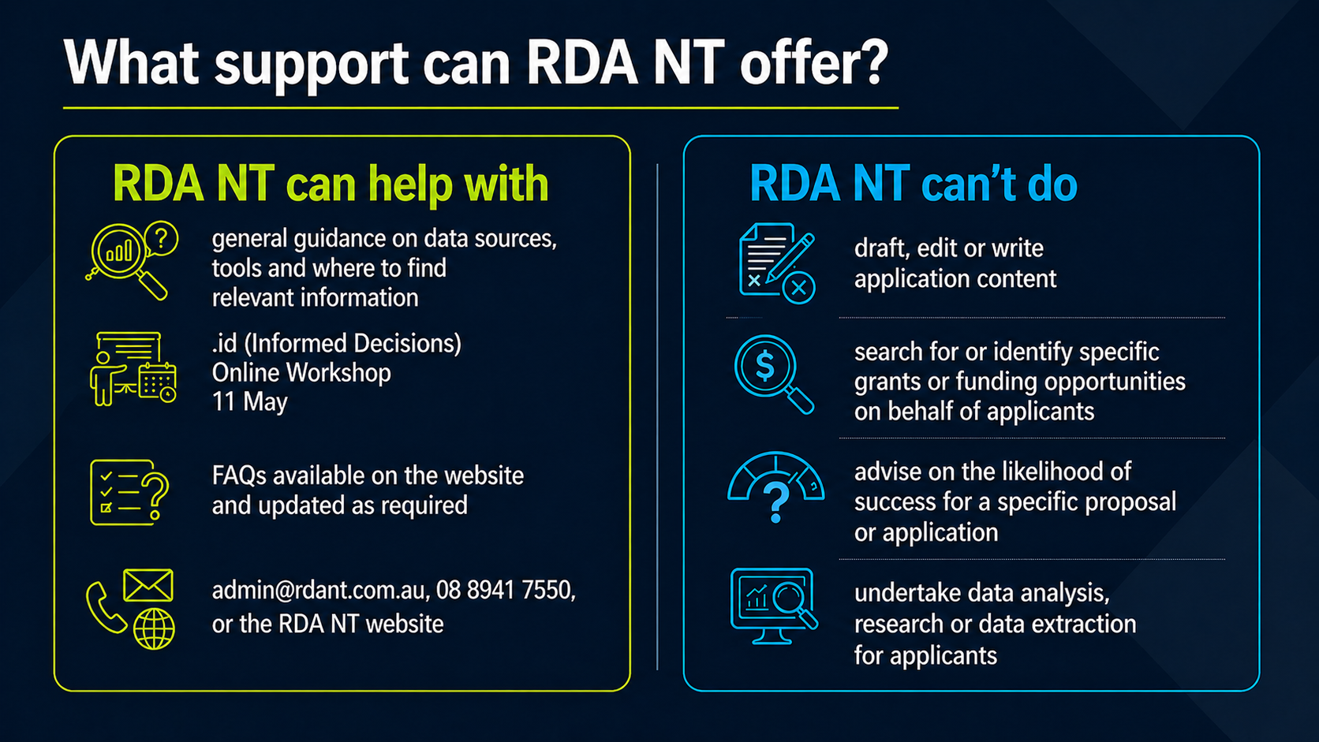
Notes:
Slide 14 – What support can RDA NT Offer
Just to be very clear about our role in supporting applicants. This is different to how we might operate in support we may have previously provided your organisatoin. As we are delivering this grant, to avoid any conflict etc. we need to be clear on what we can and cant provide in terms of support.
We can provide guidance — including:
General guidance on data sources and tools- found on our website
If you need data- we’re offering an online workshop on 11 May with .id (informed decisions_
FAQ’s on our website that will be updated as required.
[PAUSE]
However, we do not:
draft or edit application content
identify or search for grants on your behalf
or undertake research or data analysis
Or provide advise on likelihood of success.
[EMPHASISE]
That responsibility sits with the applicant — and that is intentional.
Our role is to enable and guide —not to develop applications

Slide 15
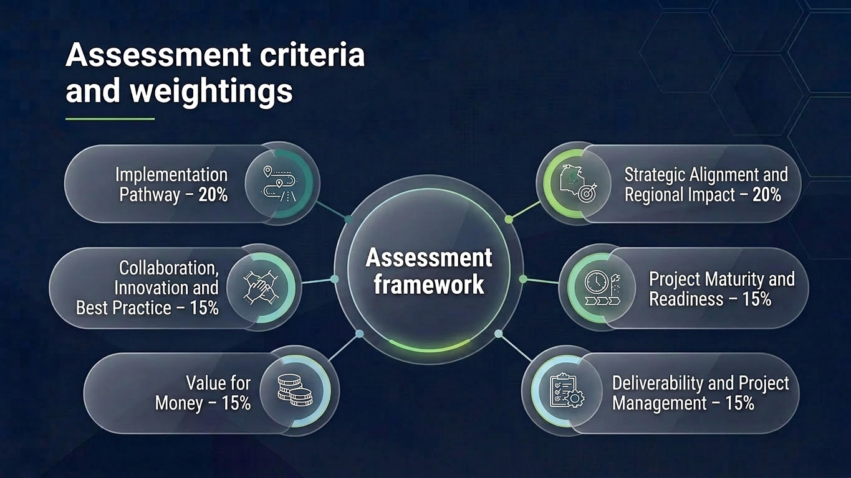
Assessment Criteria and Weightings
Notes:
This slide explains how applications will be assessed.
Applications will go through a structured assessment process against the published criteria.
It will be assessed by an sub committee of RDA NT; and will include independent assessors to support.
Applications are assessed against a number of criteria, including:
the strength of the implementation pathway
alignment with program objectives and regional priorities
project maturity and readiness
deliverability
value for money
and collaboration
PAUSE
There may also be portfolio considerations, such as regional balance, diversity of project types, and support for priority cohorts.
The aim is to ensure funding is allocated to strong projects while also achieving a balanced overall program outcome.
Decisions will be documented and applicants will be notified of the outcome in writing.
[PAUSE]
The implementation pathway is one of the most important factors.
It’s not just one criterion —it underpins the entire application

Slide 16
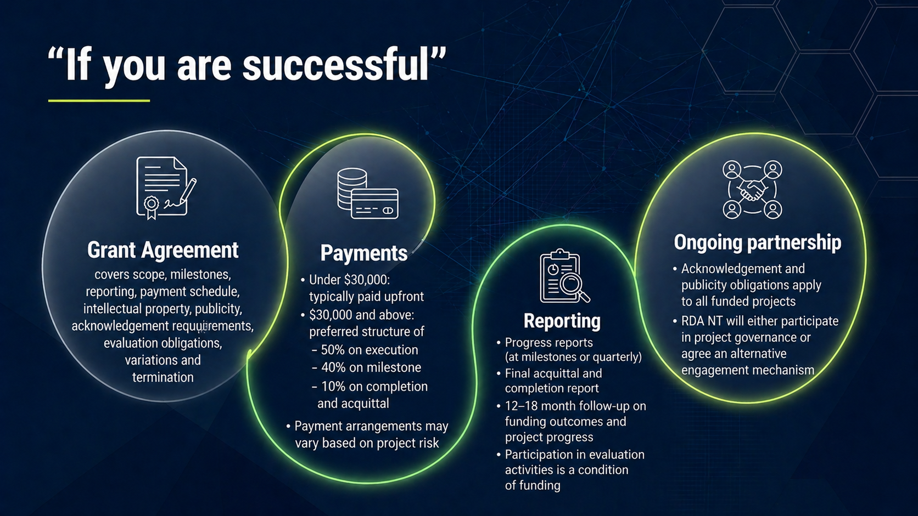
Notes:
If your application is successful,you will enter into a formal grant agreement.
This agreement will outline:
project scope
milestones
reporting requirements
and payment arrangements
PAUSE
Payments are typically staged and linked to milestones,and may vary depending on project risk.
[PAUSE]
There are also reporting requirements, including:
progress reporting
final acquittal
and follow-up on project outcomes
[EMPHASISE]
Participation in evaluation activities is a condition of funding.
PAUSE
There is also an expectation of ongoing partnership,including acknowledgement of support from RDA NT and the Australian Government.
RDAN will either participate in project governance eor an agreed alternative.

Slide 17
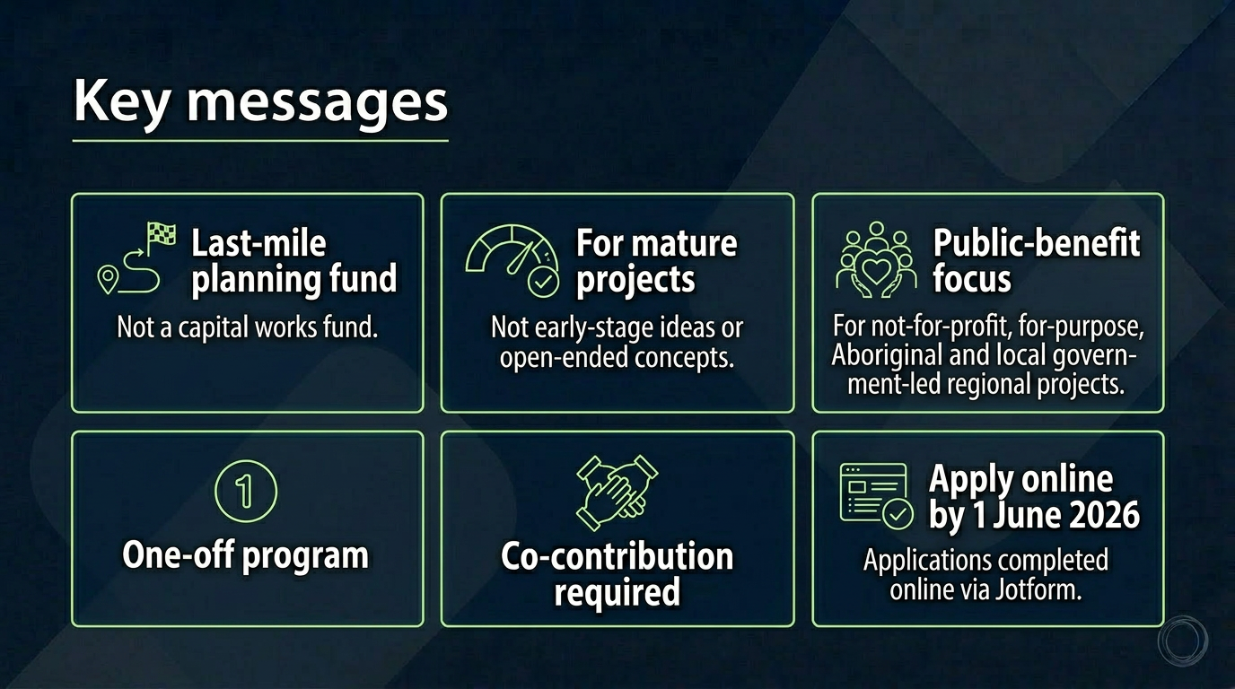
Notes:
All program information — including guidelines and FAQs —is available on our website.
We strongly encourage you to review these before applying.
We’re also running an .id (Informed Decisions) online workshop on 11 May,which will support applicants to better understand how to access and use data.
Registrations will be opening soon and information will be on our website.

Slide 18

Notes:
Thank you —
I’ll pause there and open it up for any questions. If you can use your buttons to raise your hand

Slide 19
